Slide 1

Next
Power Apps Case Studies

Slide 2
Case Study - I
A leading FMCG company conducts reselling of its old laptops .
Preference is given to internal Employees .
The company wishes to deploy a power apps portal to accommodate the process asap.
Next
Objective
Challenges
Solutions
Workflows managed in Power Automate to provide
Notifications to stakeholders for approvals on Teams as well as Power Apps Portal
Approvals via Microsoft Teams or Email.
Real time database updation.
To establish a portal where employees , can buy old laptops listed by the company for reselling .
Notifications to relevant stakeholders during the whole process on Teams , Emails.
Maintain a single sign in for everyone while showing them data relevant to them
Provide a common platform for Treasury , IT , Buyer , Asset Management, Receivables Department and keep everyone in loop during the process via notifications

Slide 3


Make order in app
Pay for device
(Pay within 2 weeks)
Update in app with proof of payment
Buyer
Start
Prepare and list devices
Release device
Update in app that device is released
IT
Confirm payment received
Update in app that payment received
Treasury
Process billing & clearing
AR
Remove device from asset list
Asset

Slide 4
Case Study - II
A leading Trading company want to track the claim settlement process of items returned by the customer while keeping in view the Root Cause Analysis of the Non conformance for further analysis
Next
Objective
Challenges
Solutions
Maintaining a database for the details as well as Root Cause Analysis part
Workflows managed in Power Automate to provide
Notifications to stakeholders for approvals on Teams as well as Portal
Approvals based on majority approvers approving the process
To establish a portal for settling claims of returned items.
To Track the approved Claims , Pending Claims and Settled Claims while creating a summary of each stage
Managing approvals through the response capturing of Approver Groups
Maintain a single sign for data analyst and approvers while showing them data relevant to them

Slide 5
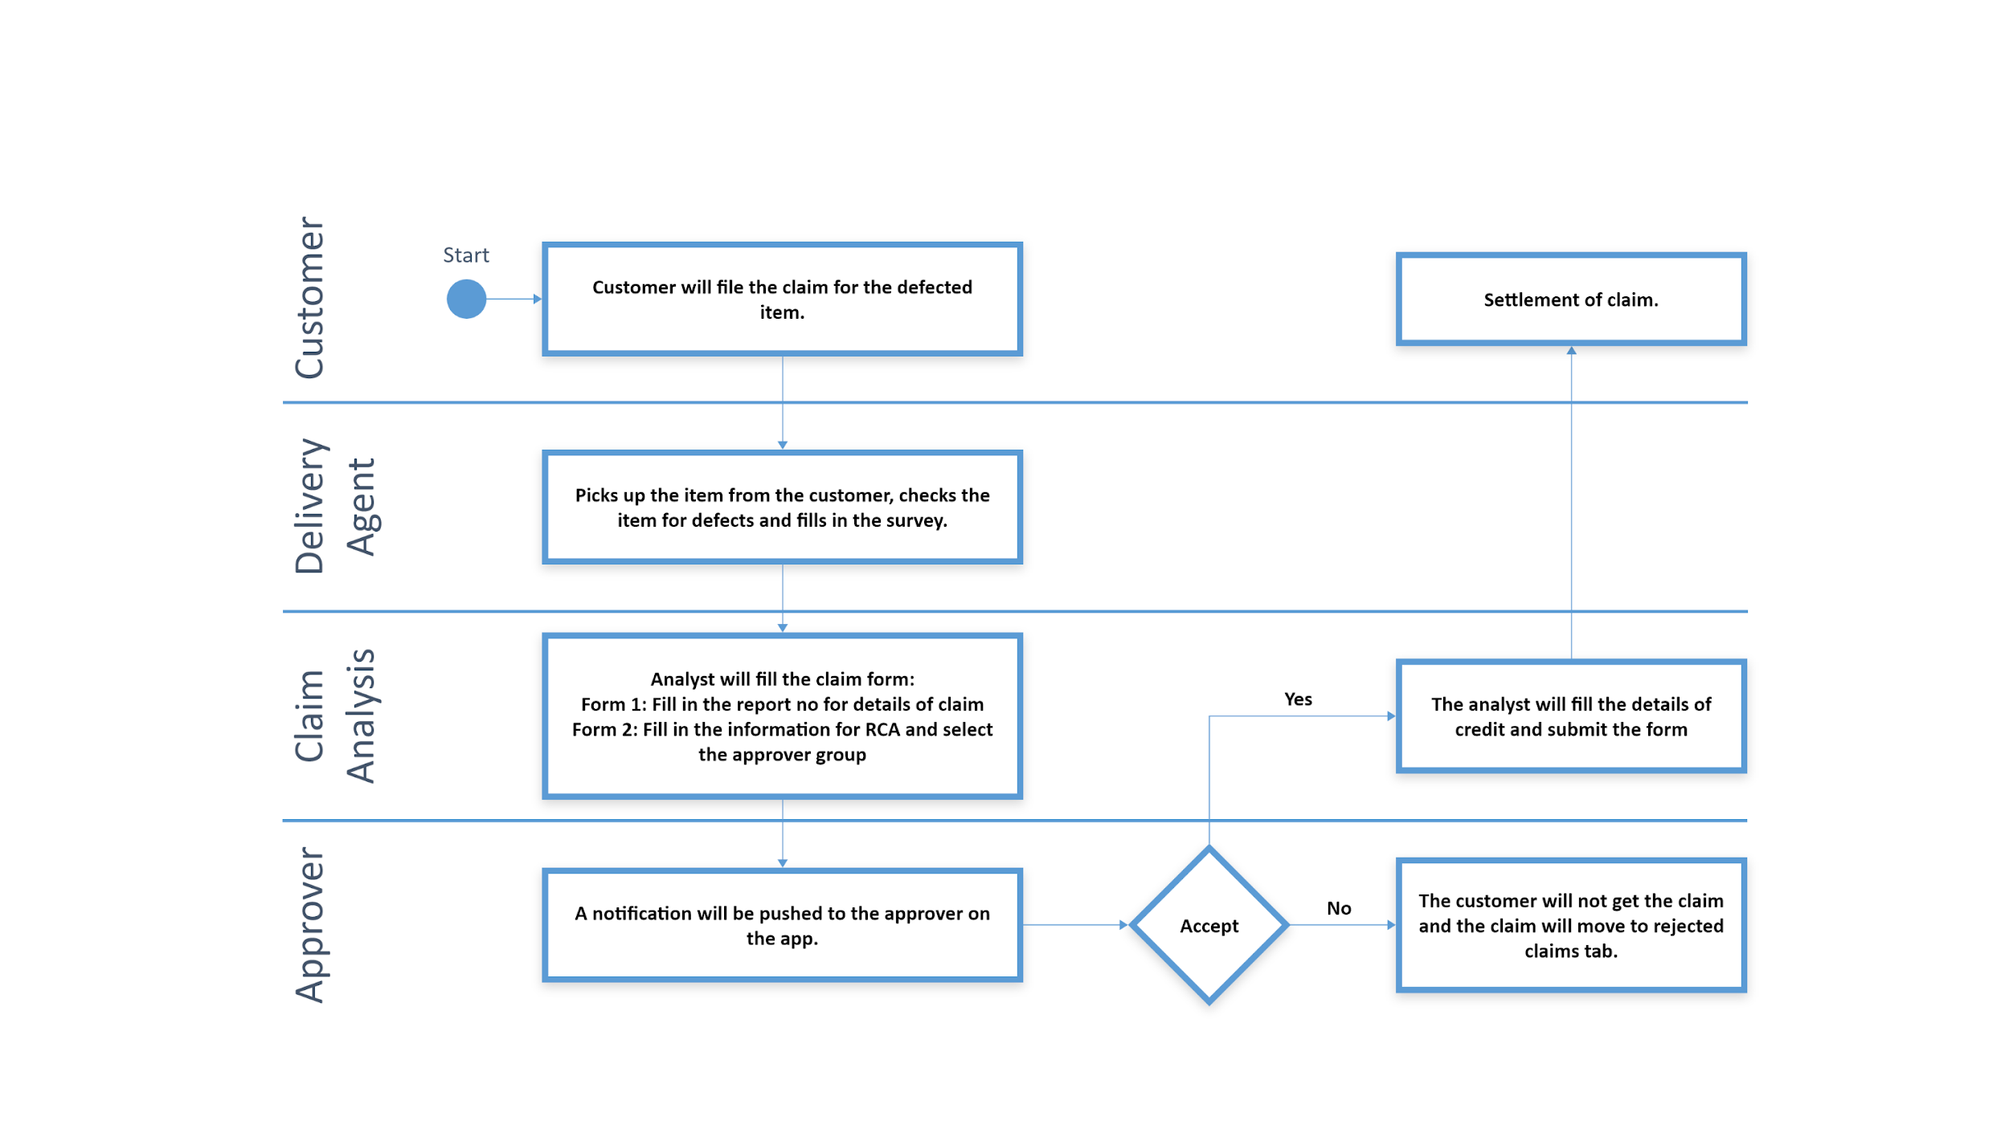

Slide 6
Case Study - III
70+ Field users (Salesperson) are able to view the task assigned and complete it .
Expenses can be claimed and tracking to be done via notifications.
Activity Tracking , Task Management to all the Area Sales Managers about their Salesperson.
Next
Objective
Challenges
Solutions
To create an app for the field users to capture their location through their punch in , Assign task to them and providing them a platform to file their expenses/claims for settlement
Capturing Current location , data and time of the employees.
Managing a single notifications system throughout the workflows
Single Sign on for ASM and salesperson
Created workflows on Task Management and Expense Management.
Approvals managed on Microsoft Teams and Gmail via Power Automate
Tracking the workflows via notifications and tabs on screens
Track Activity Section for Recent Activity tracking of the Salesperson

Slide 7
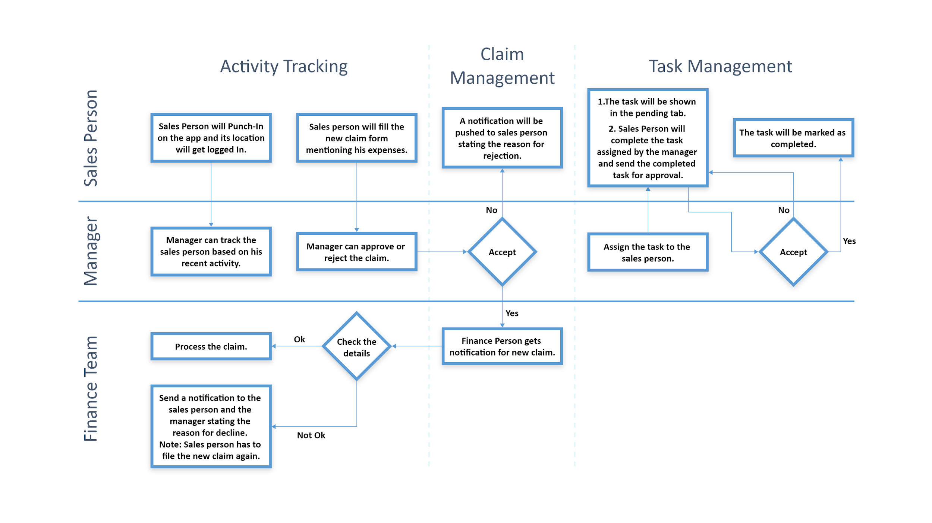

Slide 8
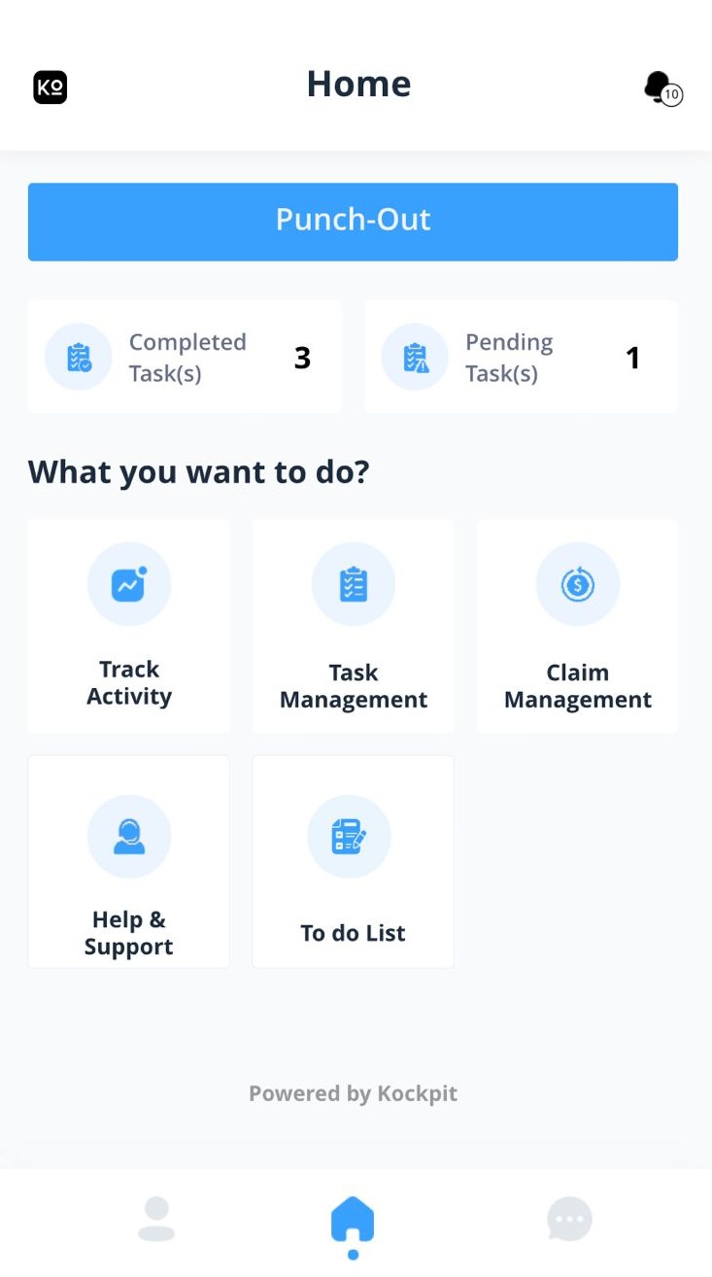
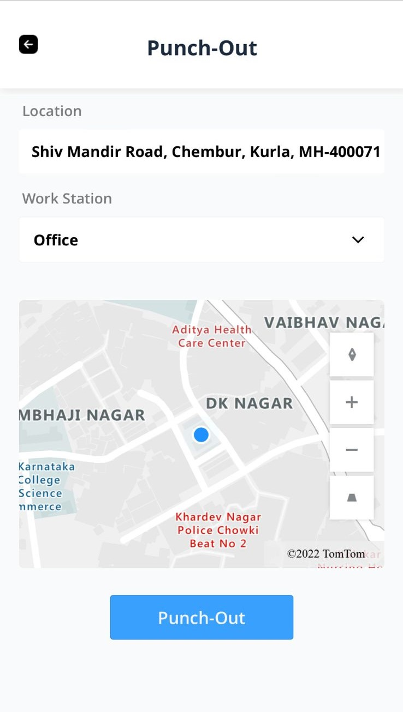


Slide 9
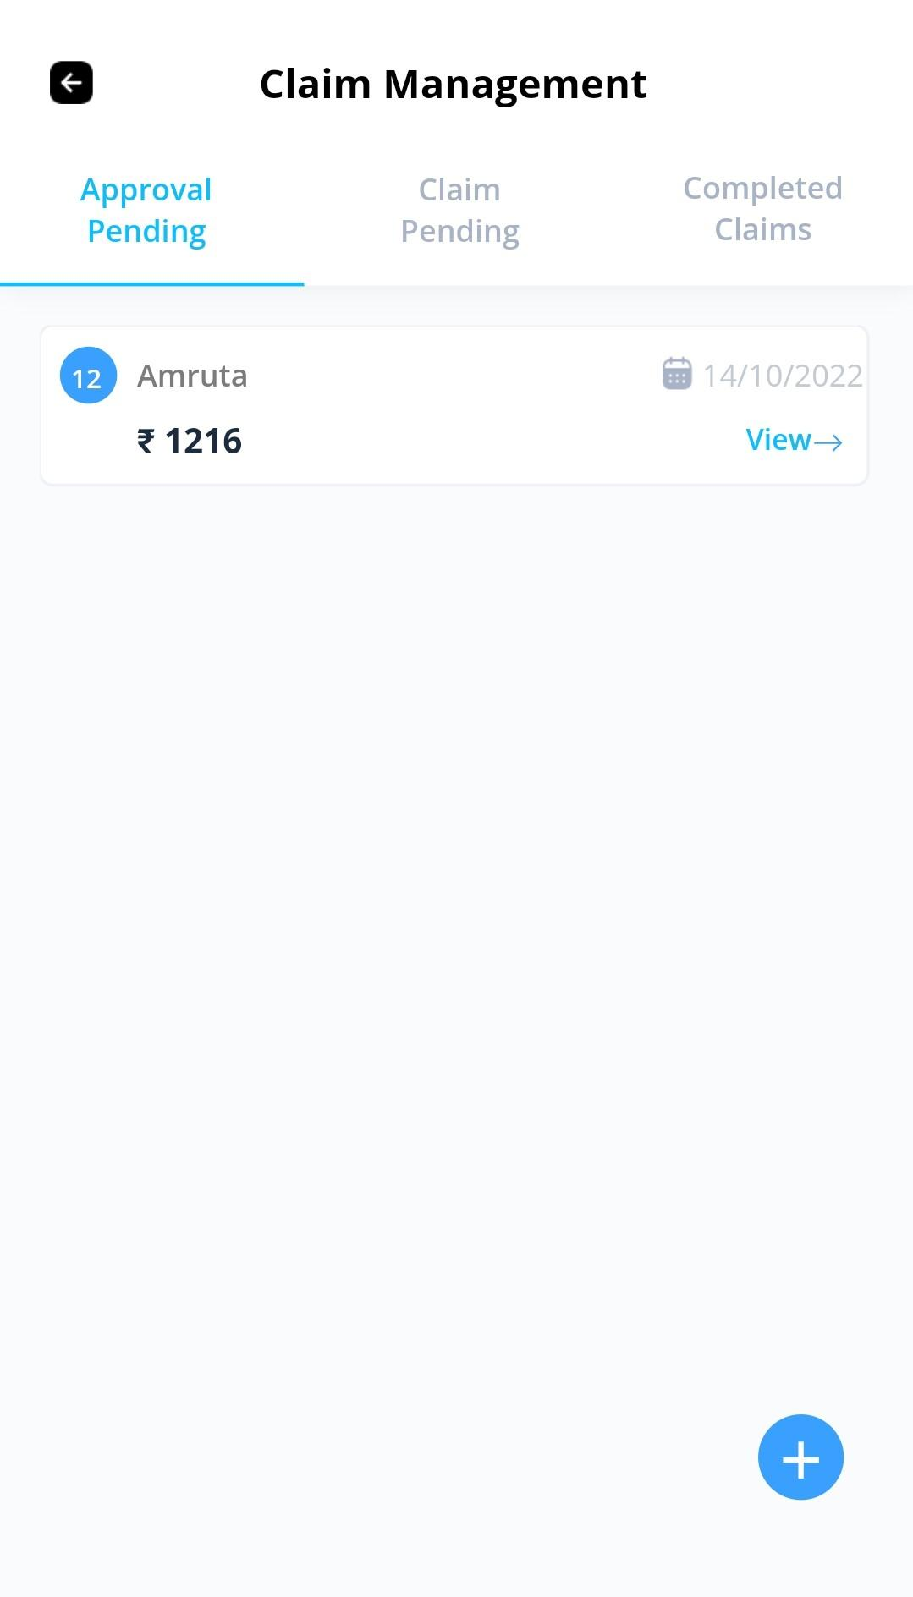
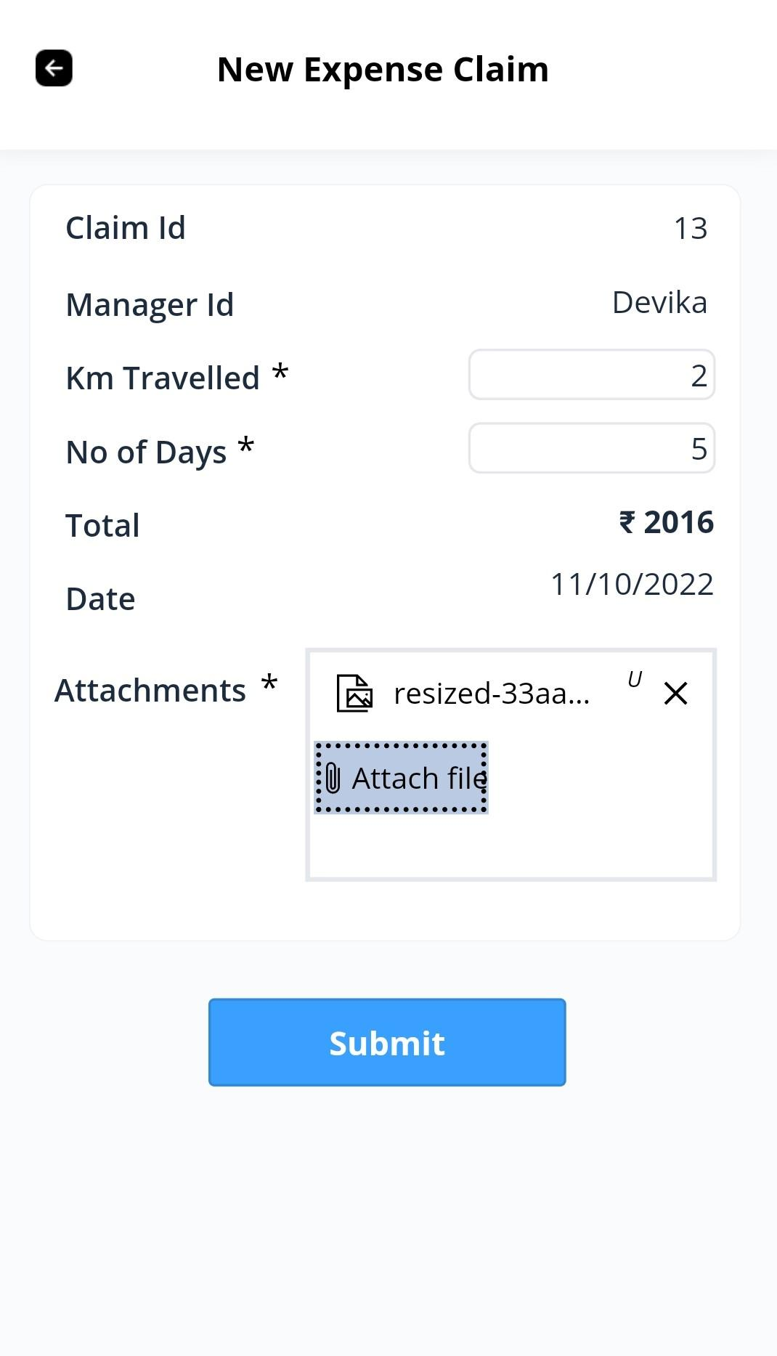

Slide 10
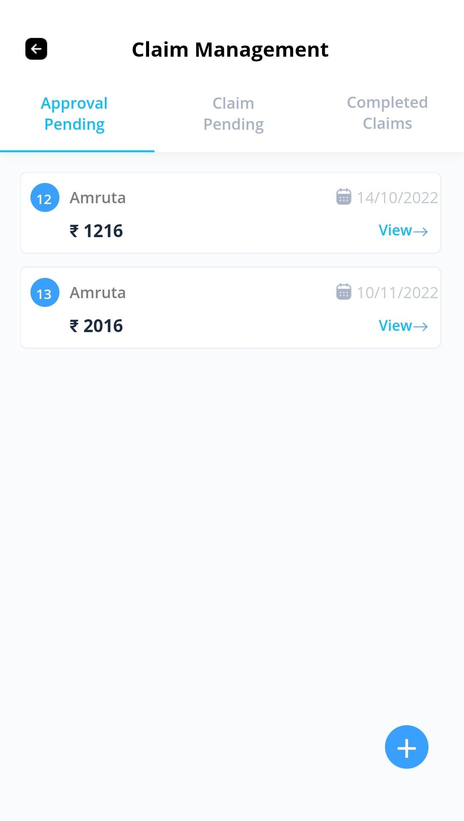
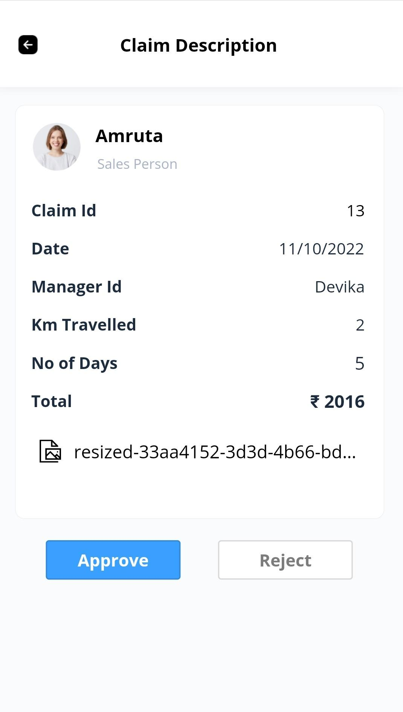
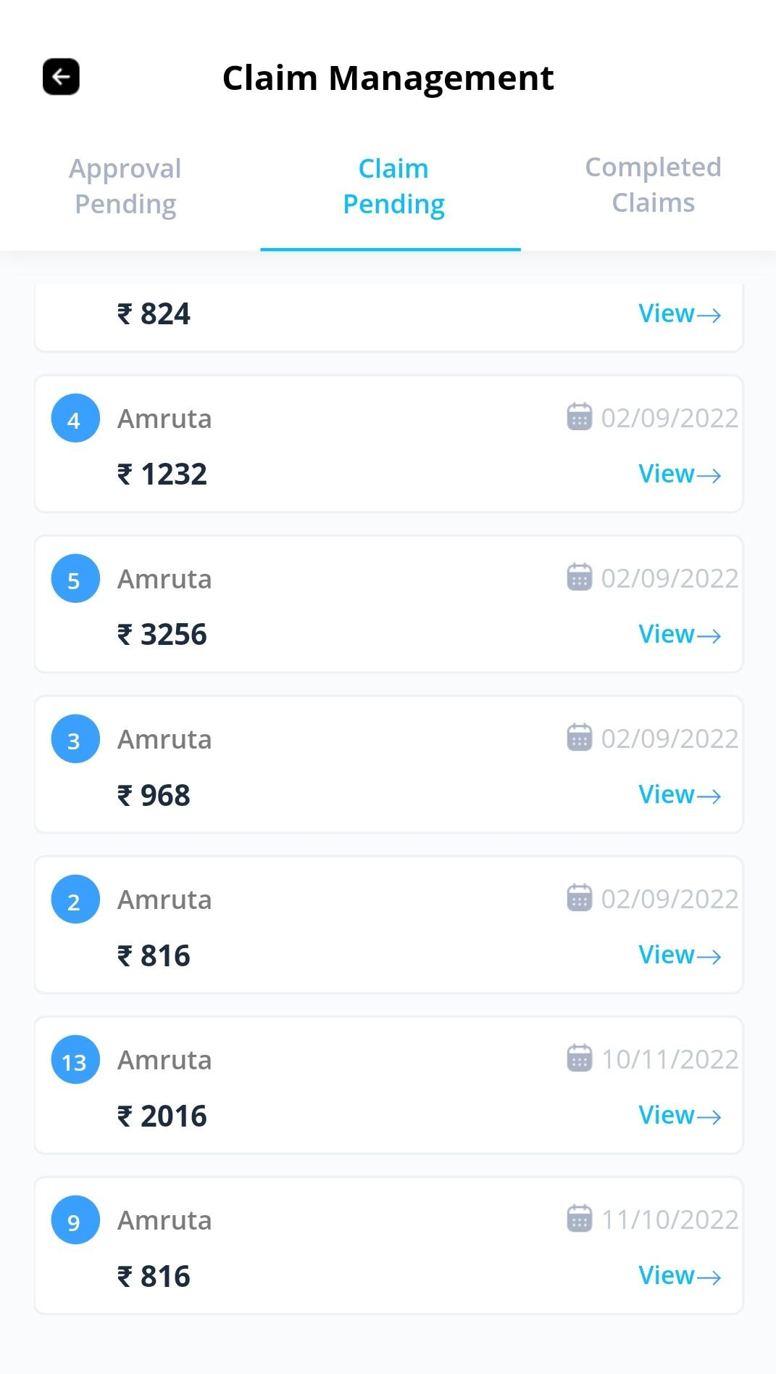

Slide 11
Case Study - IV
A Trade Association is running Covid -19 vaccination drive for its 11000+ employees .
It wishes to track the employees .based on region and job function in which they lie.
Target is to cover 100 percent asap.
Next
Objective
Challenges
Solutions
To create an app/portal for updating status by team and providing visibility to management about Vaccination drive on Covid-19 (I and II dose ) in organization.
Respective Regional and Department HOD’s should be able to see the data pertaining to their regions only
Capture the certificate as attachments in database.
Common Data warehouse established to merge all the regional and zone wise reports under one schematic form
Clear Visibility provided via Power Apps to all the stakeholders involved

Slide 12
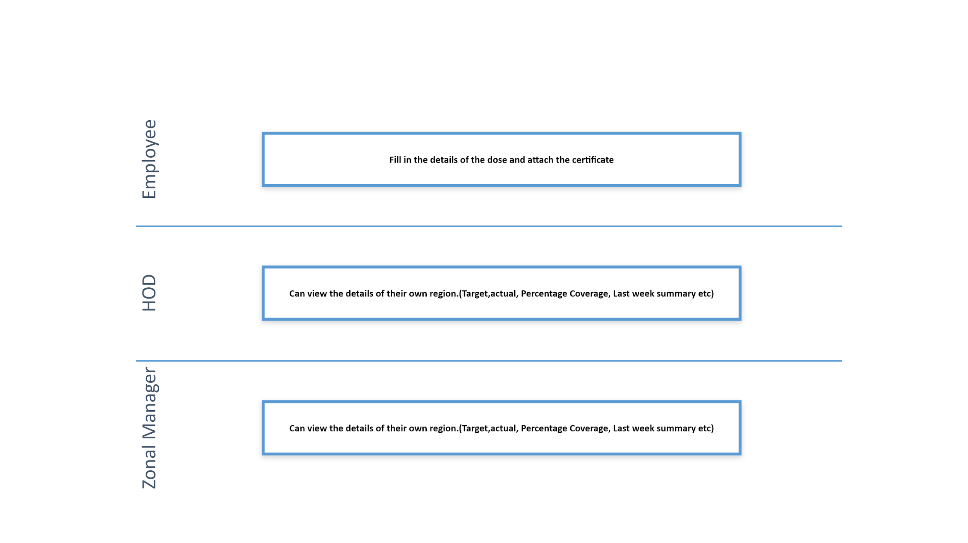

Slide 13
Case Study - V
An organization wanted to do the whole process till business requirement created to interview with panelist on the single portal. Which consist of Business Stack Holders, Vendors, HR, panelists.
Next
Objective
Challenges
Solutions
Provided a platform to handle recruitment process from creating requisition to finalizing candidate.
Common Data warehouse established to merge all the Vendors reports under one Vendor performance.
Tracking the workflows via notifications and tabs on screens
To establish a portal where business stack holder can create the job requisitions.
Respective vendors should be able to view requirements shared to them and share candidate for the same.
Insights of vendor performance.
Managing a single notifications system throughout the workflows .
HR can send the business requirements to the vendors.
Vendors can upload the candidates.
HR can scheduled the interview.

Slide 14
New Job Requisitions
Candidate Approval Process
Interview Process
Business Stakeholder
New Job Requisition
Notification of Rejection
Approval Response
Reject
Accept
Job Details available under New Requirement
Approval against requirement.
Move to reapply tab and can reschedule interview
Recruiters
Vendors Selection
Schedule 2nd round of Interview
Generate Offer letter
Reject
Shared to vendor
Accept
Notification to Vendor with remarks
Notification to Vendor.
Vendor
Upload the candidate and send for approval
Move to reapply tab and can reschedule interview
Schedule Interview as per available slot of panelist.
Alert via email
Didn’t Happen
Didn’t Happen
Block Interview slot on calendar
Interview Response
Reject
Block Interview slot on calendar.
Interview Response
Accept
Panelists
Accept
Reject
Notification to Recruiter with remarks

Slide 15
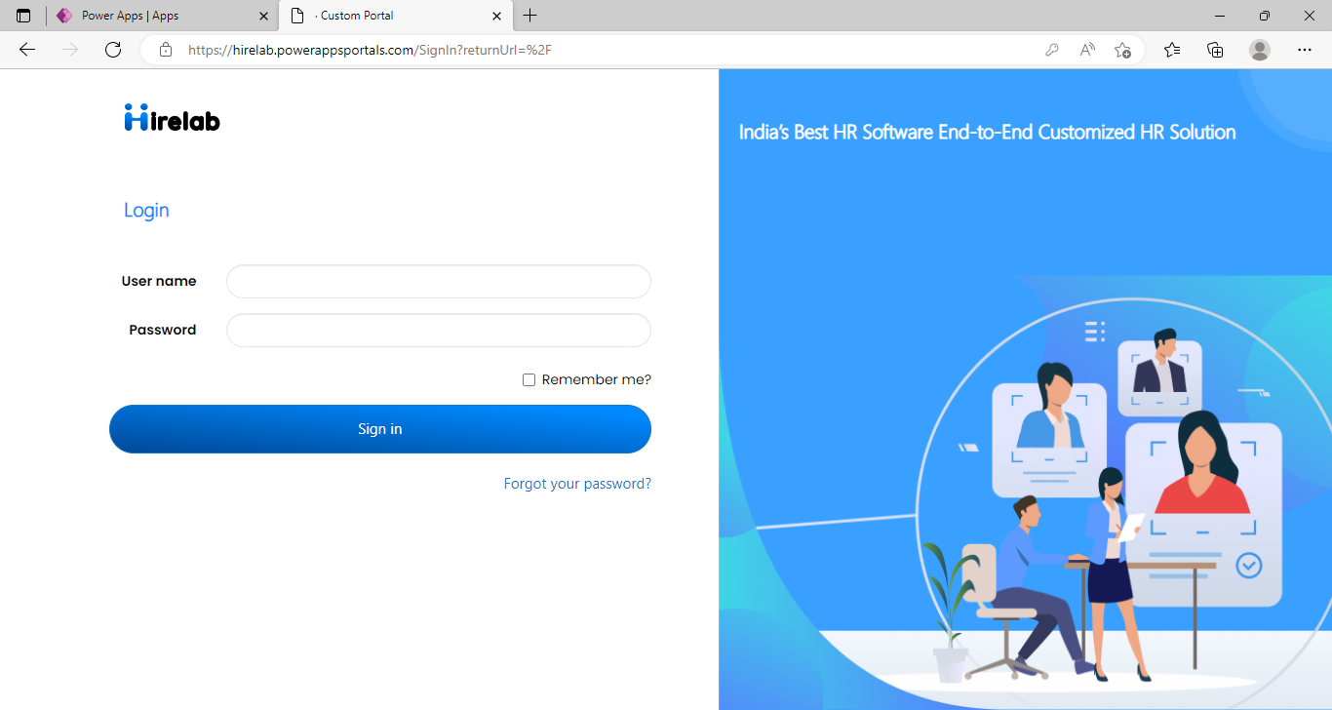
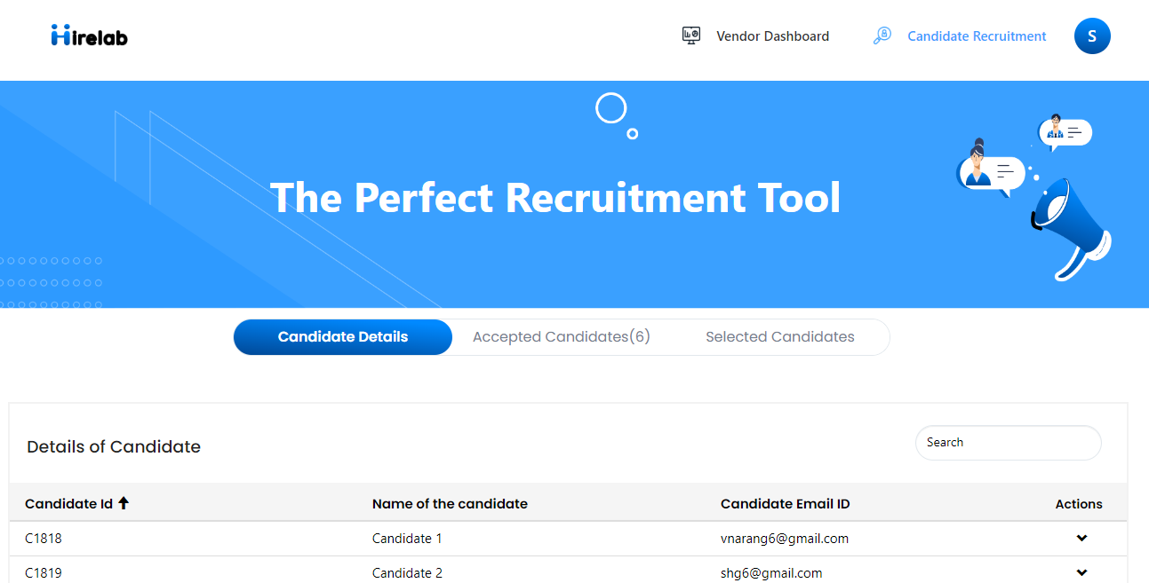

Slide 16
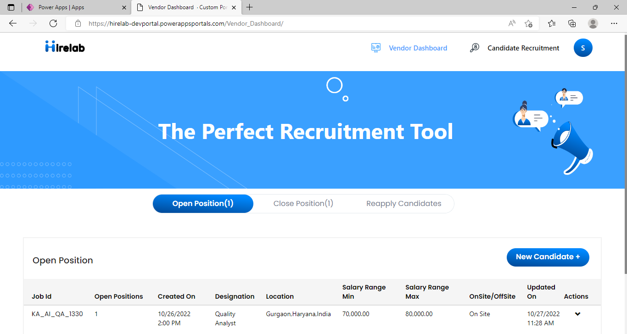
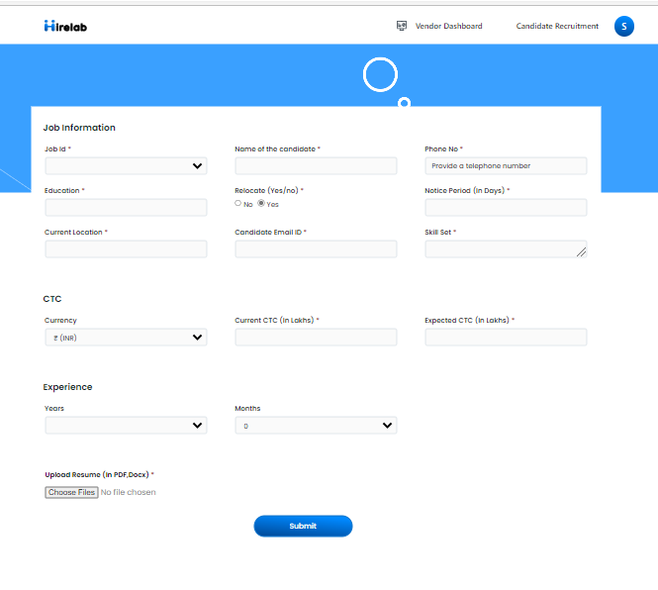

Slide 17
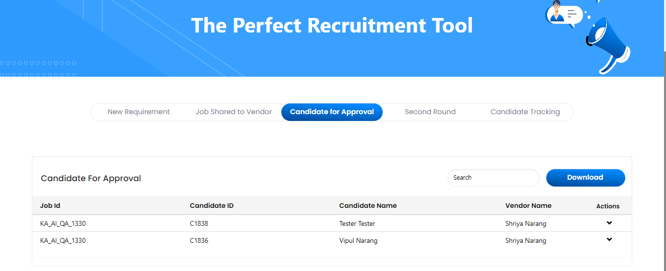
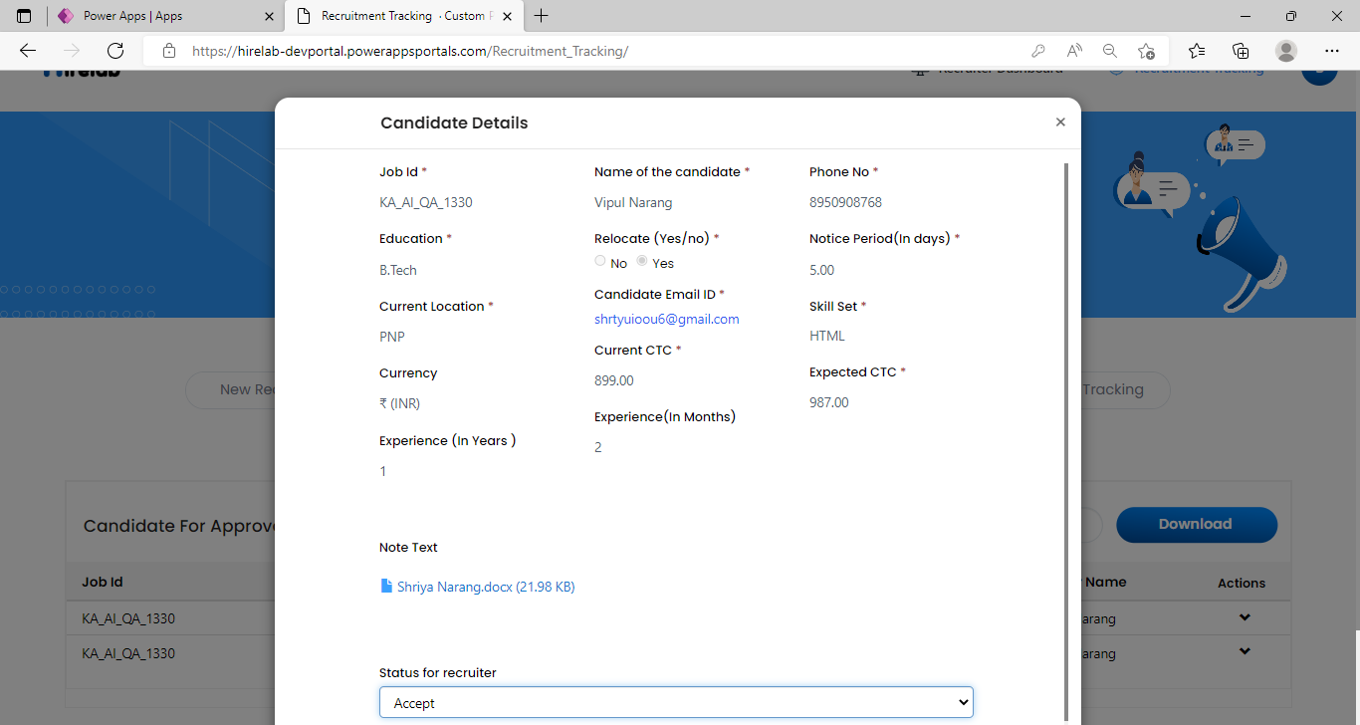

Slide 18
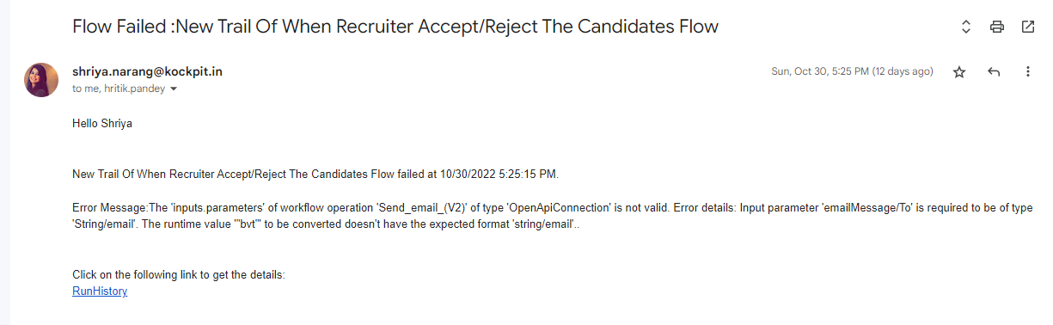
Exception Handling : Notification received for every error occurred

Slide 19
Case Study - VI
An organization wanted to create the timesheet portal for the employees. Where they can upload their daily activity with their projects name, time on the activity and summary of activity.
Next
Objective
Challenges
Solutions
To establish a portal where employees can fill their daily timesheet.
To make the timesheet draft and submit later.
Create power automate flow for the draft and submit process.
Created restrictions on the columns using JS.
They can save it to the draft and submit it later.
They can add the multiple entries for multiple projects.

Slide 20
Submit
View
View
Employee
Employee will create new Timesheet
Edit
Submit
Save as a Draft
Login
Delete
Submit All

Slide 21
Case Study - VII
An organization wanted to create an app through which they can create requests to the vendor for the different purpose for which vendor can also respond and they can also track about pending and completed request on home screen by KPIs and notification can sent to marketing team also when request is created where they can track the completed and pending requests in dashboard.
Next
Objective
Challenges
Solutions
To create an app by which requester can create request and vendor can respond.
Add new customer address if not available in master
Provided text column to fill new customer name and address
They can also track their claim and completed request status through KPIs.
They can see the details of their multiple requests.

Slide 22
Create Repair Requests
Fix Repair
Reporting
Sales Person
Notification on Completion
Pending and completed job Status with pending buckets
Create the repair request by adding job type , location , customer etc
Job Assignment to appropriate vendor based on region and job type
Go to Assigned Location marked during creation
Mark the job as complete in app
Pending and completed job Status with pending buckets
Vendor
Marketing
Personnal
Pending and completed job Status with pending buckets , TAT calculations

Slide 23
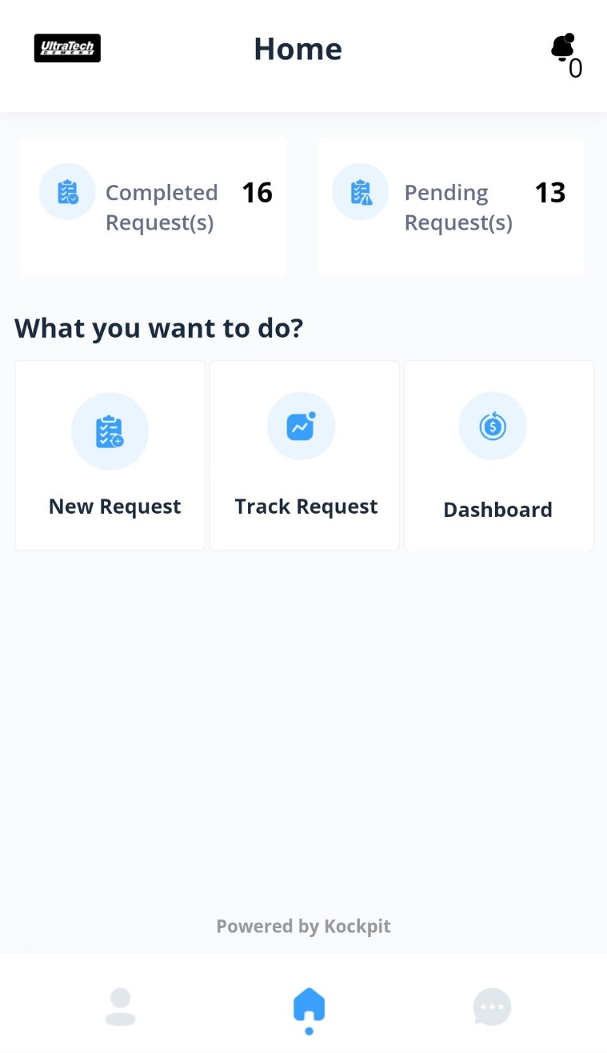
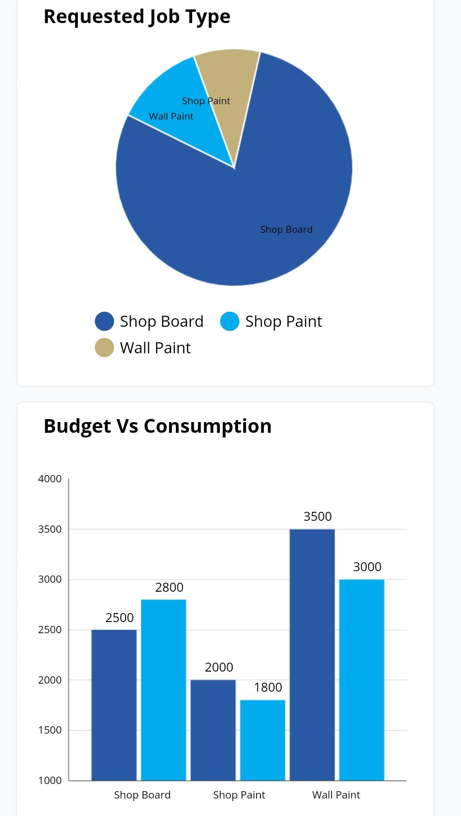

Slide 24
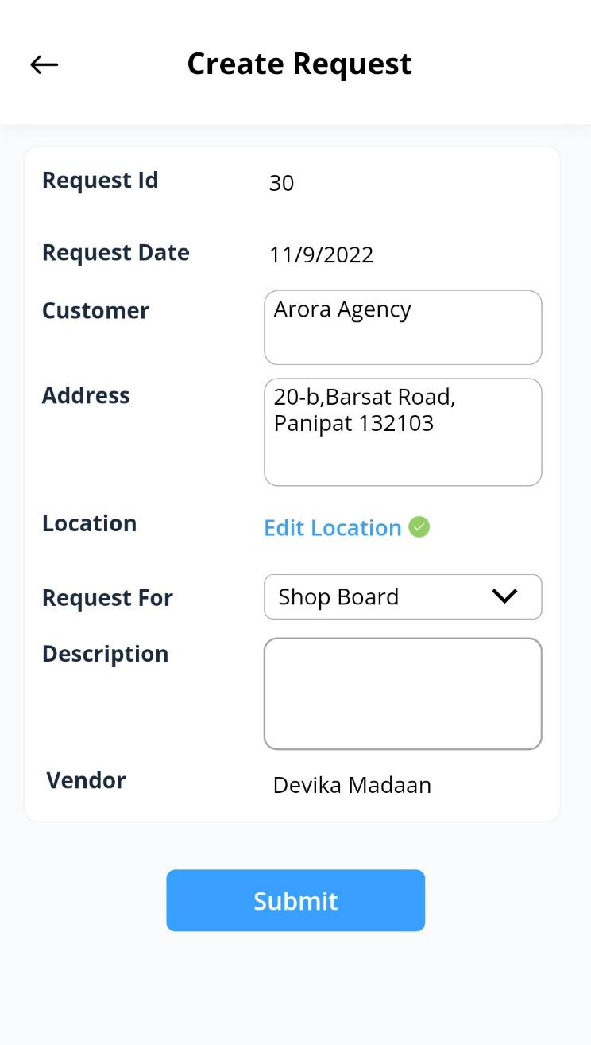

Slide 25
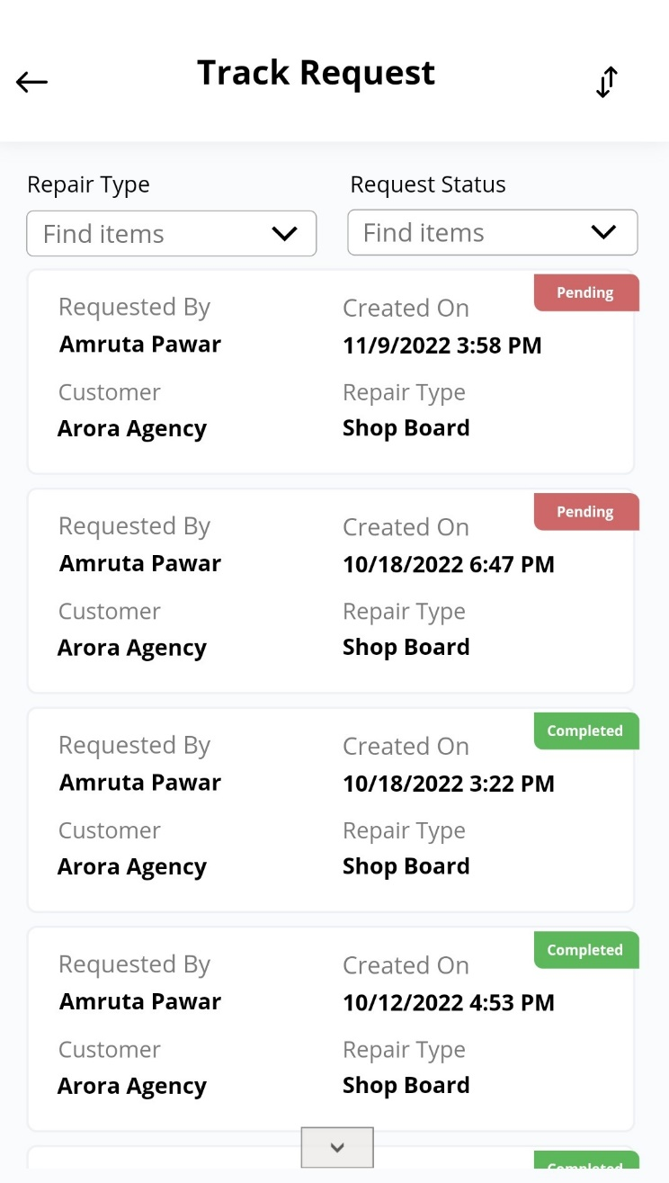
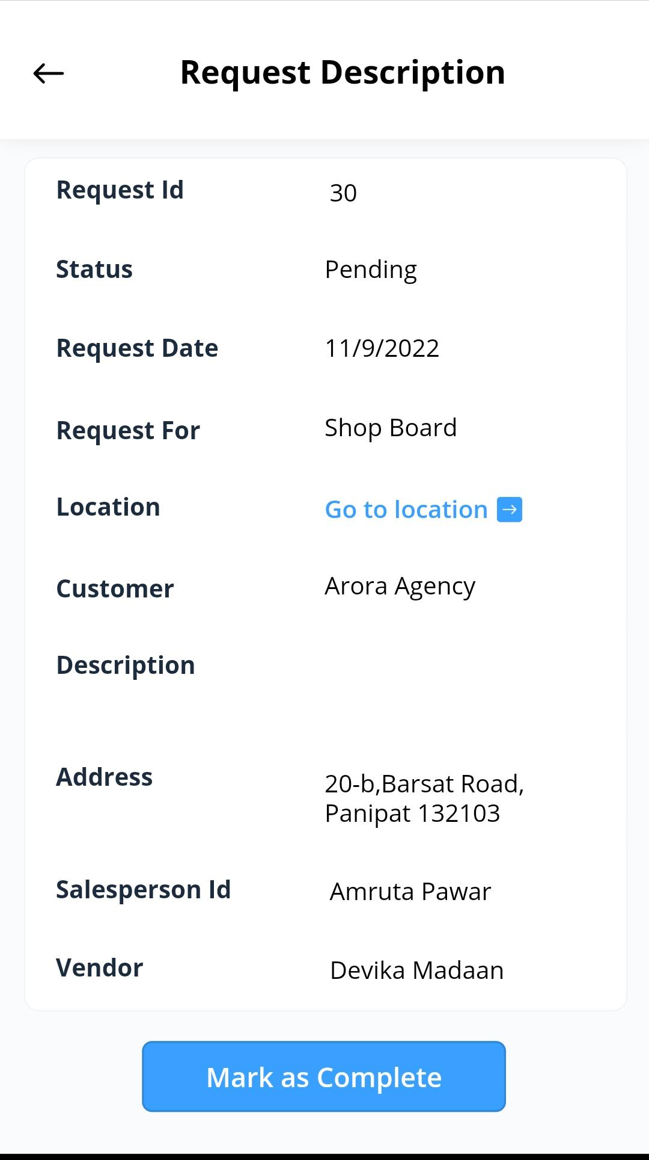

Slide 26
Case Study - VIII
An organization wanted to read pdf document and convert it into the excel sheets.
And they also wanted to read excel file and fetch only distinct column and rename it.
Next
Objective
Challenges
Solutions
To read the pdf file and convert it to the excel file with tables.
Mapping different input file columns to output file columns.
Reading the data of pdf and converting it to the excel sheet in the table format.
Creating configuration file to map input column to output column.
Used the AI builder in the power automate to red pdf file.
. To read the excel file and fetch only important columns and renamed it.

Slide 27
Flow for Excels to extract the relevant Fields as per defined master
Append the Excels in single excel file
User
Login
Upload PDF/Excels in blob
Trigger Flow
(Manual/Scheduled
Place the file in output folder for user to download
Convert PDF to Excel using OCR Engine
Power Automate Flow to extract the relevant Fields as per master
Admin
Manage the master format to extract the columns
Login

Slide 28
Thanks

